Slide 1
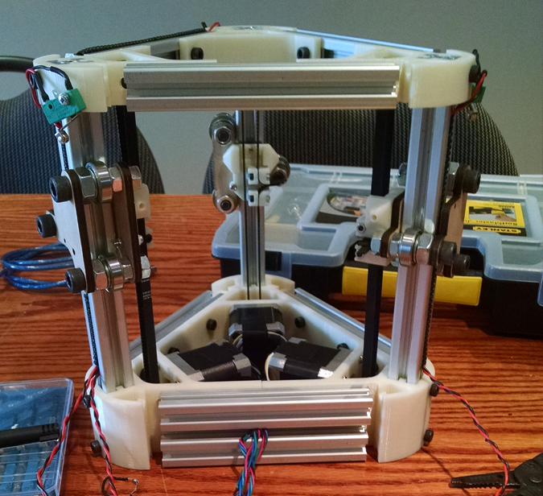
Delta Laser
Dave Mariano and Jordan Humphries

Slide 2

The Mini-Kossel Delta 3D Printer

Slide 3
Backend and Algorithms Roadmap
January:
● Project Proposal
● Print/Cut and Order Parts
● Begin Software Research and Development
● Assemble
February:
● Finish Assembly
● Troubleshoot RAMPS and Arduino
● Troubleshoot RAMPS with new Arduino
● Continue Research and Development
March:
● Develop Python Script and Load on Raspberry Pi
● Test Input into Pololu Drivers
● Test New RAMPS with Working Arduino
● Test Server with Delta Robot
● Install Required Software on Raspberry Pi
● Test Server and App via Raspberry Pi

Slide 4
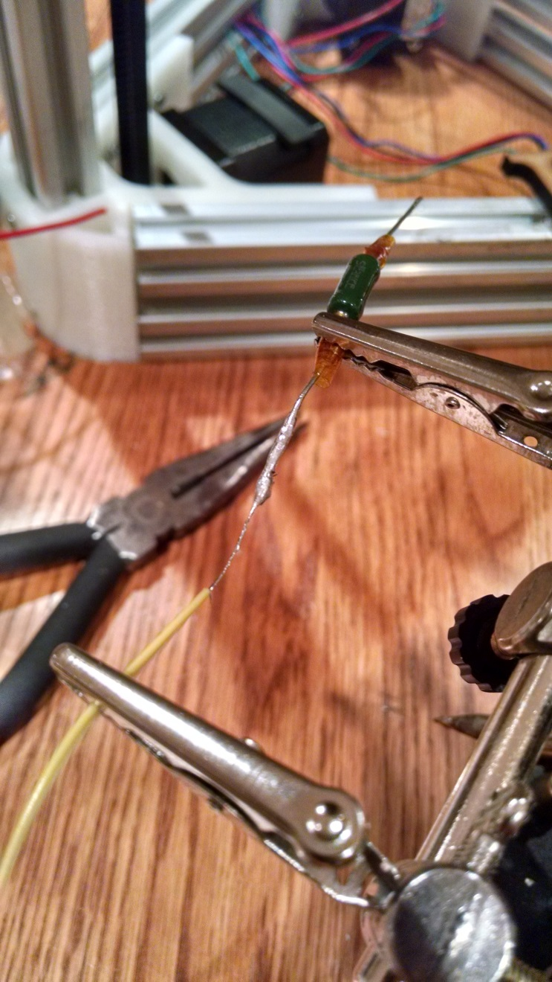
Skills in Hardware
Course of References:
● Electric Circuits (TECH 101) - Embedded Systems
● Hardware Production Technology
Skills:
● Measuring Voltages and Resistance
● Working with Stepper Motors
● Soldering and Wiring

Slide 5
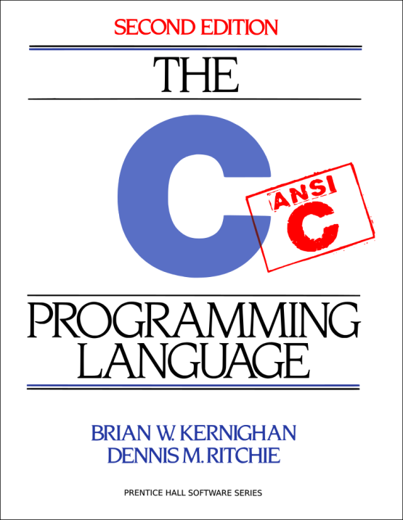


Skills in Software
Course of References:
● Technical C
● Programming Techniques in Java
● Internet Programming
Skills:
● Solid Foundation in Programming and Algorithm Development
● Learn How to Learn (API’s)
● Programming for Network Communication

Slide 6

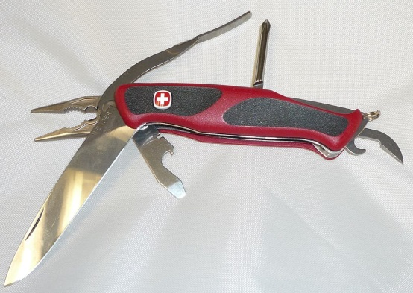

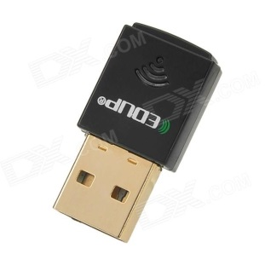
Skills in Networking
Course of References:
● Network Programming
● Networking Technologies
● Network Administration
Skills:
● Creating Client/Server Solutions
● Addressing, Protocols, Subnets, etc.
● Troubleshooting with Networking Tools

Slide 7
Planning and Schedule
App UI design
Joystick controller implemented
Socket server implemented
Signals sent to server
Subnet issue between Phone and Server
Back button for closing the socket

Slide 8
Useful Skills
CENG512 – Hardware Project
Skills with working with hardware and software
CENG509 – Socket Server Programming
The communication between the app and the Delta Laser
CENG300 – Android Development
Creation and debugging of the app
CENG510 – Java Algorithms
Advanced experience in Java
CENG609 – Network Administration
Troubleshooting the connections problems between the app, server & Delta Laser

Slide 9
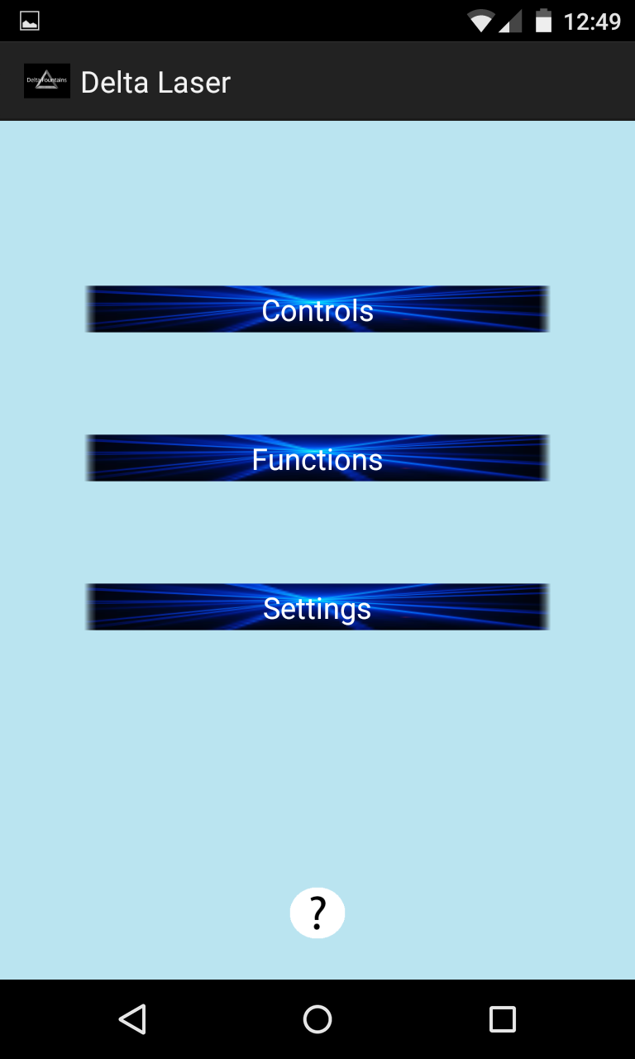
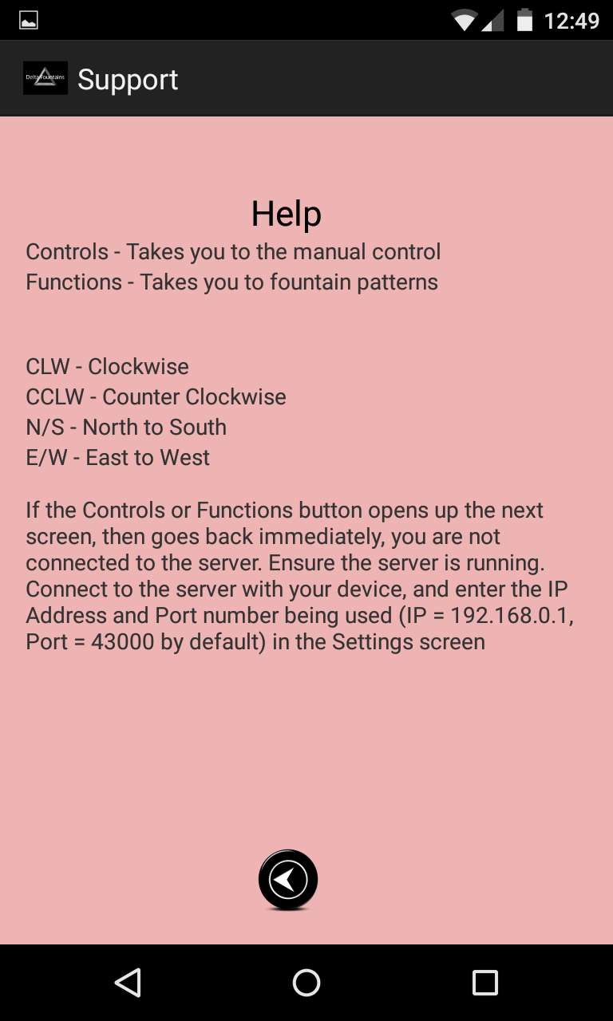
Simple UI
Three other screens
Keywords
Activities Description
Main Screen
Help Screen

Slide 10
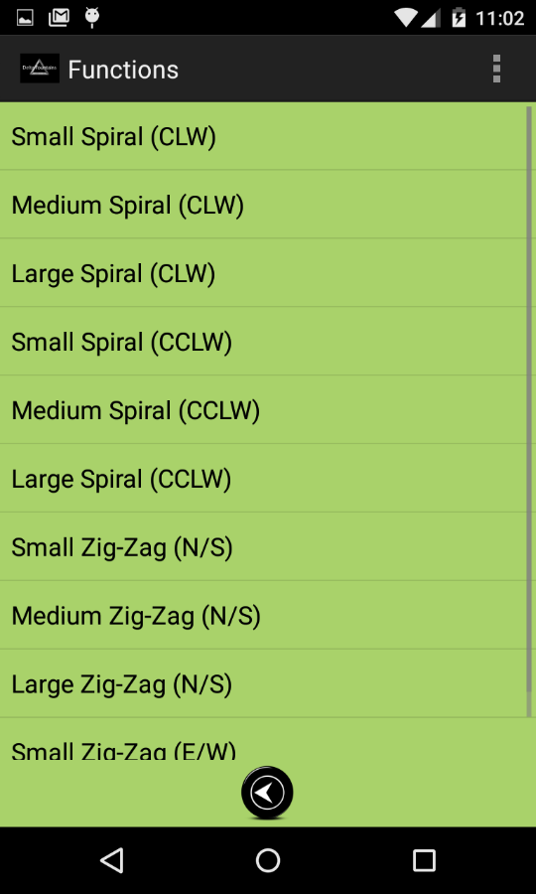
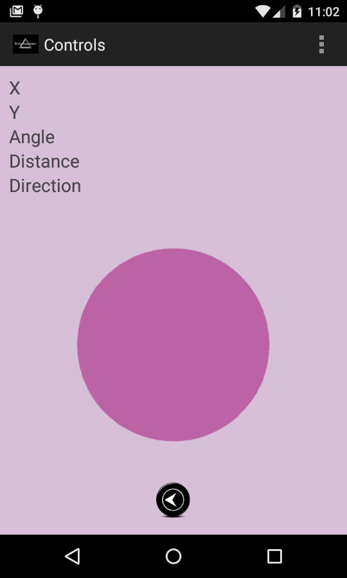

Clicking on the Controls or Functions button will connect the app to the server
Controls is a joystick that sends a bearing to the server
Functions is a list of premade patterns for the fountain
Functions Screens
Controls Screens

Slide 11
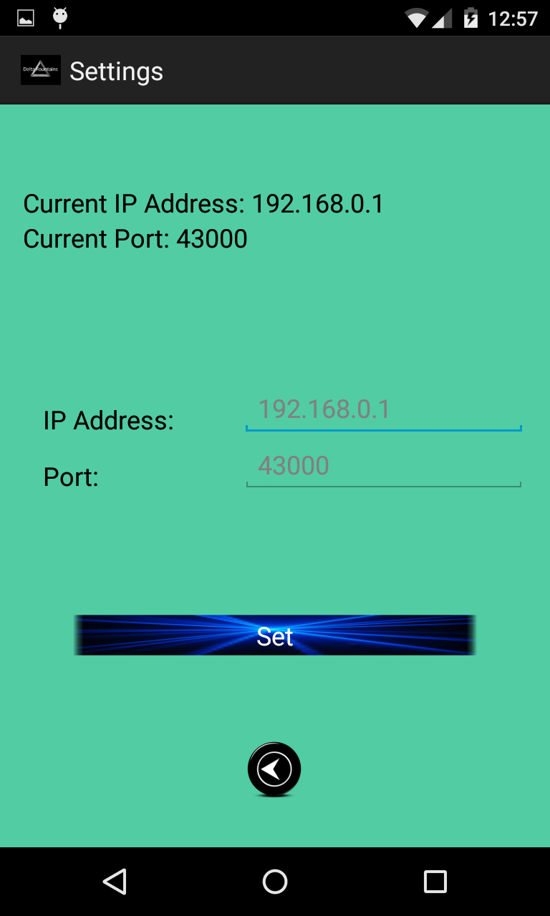
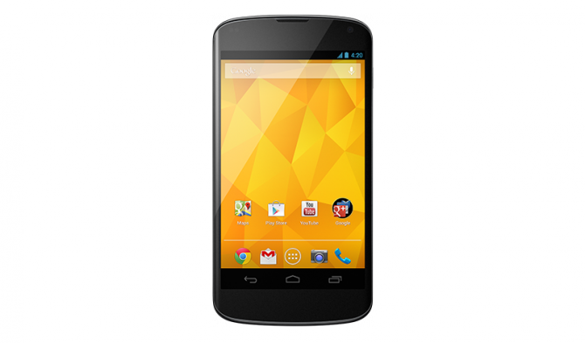


Displays current IP Address and Port number
Gives you the option to enter values
Settings Screens

Slide 12
Project Delta

